Slide 1
Eniac's Expansion into the Brazilian Market
Group 5 • 29.06.2023
Asif Siddiqui
Saddam Kafawi
Sabrina Reimann
Sergio David

Slide 2
Key Points
Is Magist a good fit for high-end tech products?
Are orders delivered on time and happy customers?

Slide 3
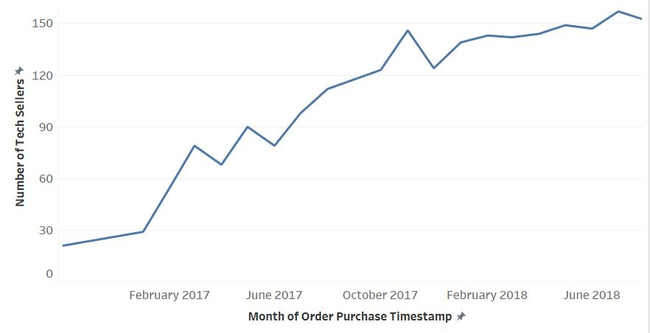
Monthly Increase of Sellers
Number of Tech sellers increased over time shows the trust in Magist performance

Slide 4
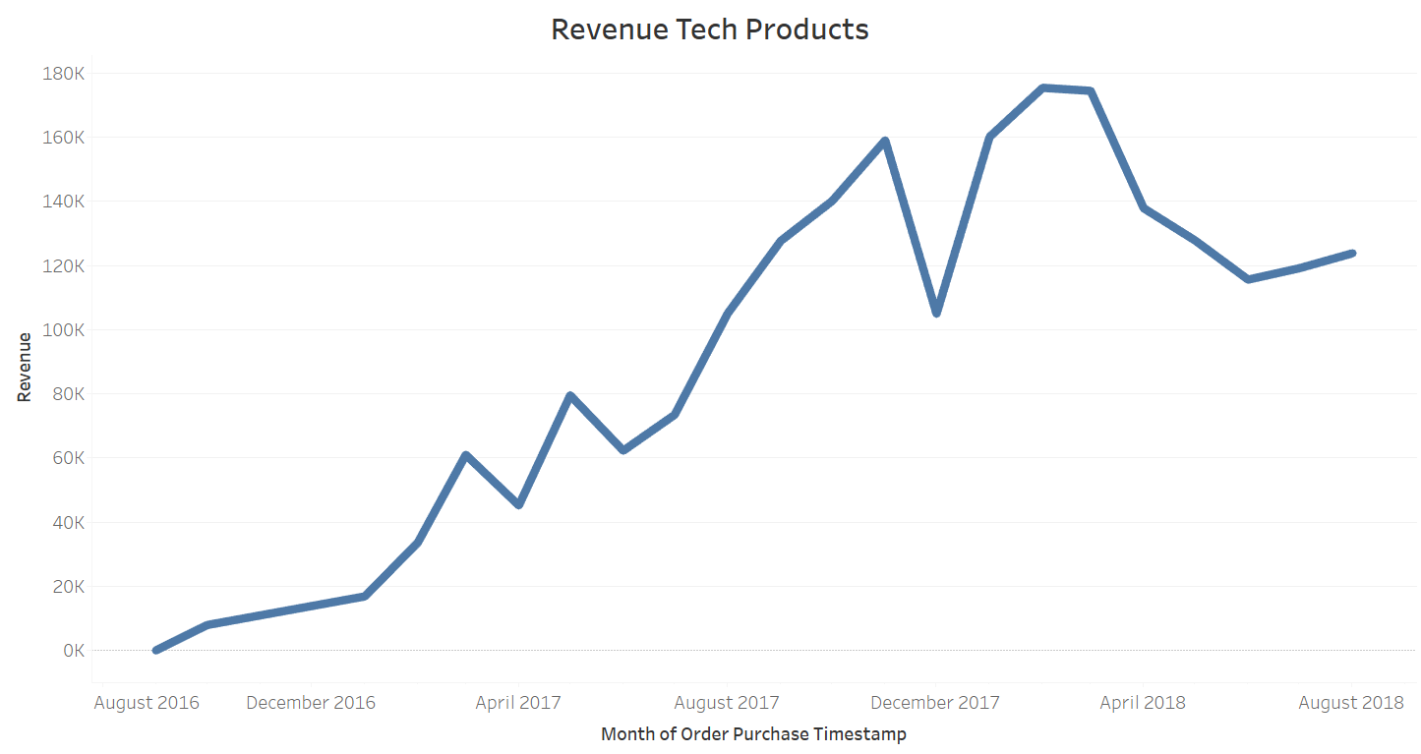
Monthly Revenue of Tech Products
Keeping in view the percentage of tech products from the over all products is 15 %

Slide 5
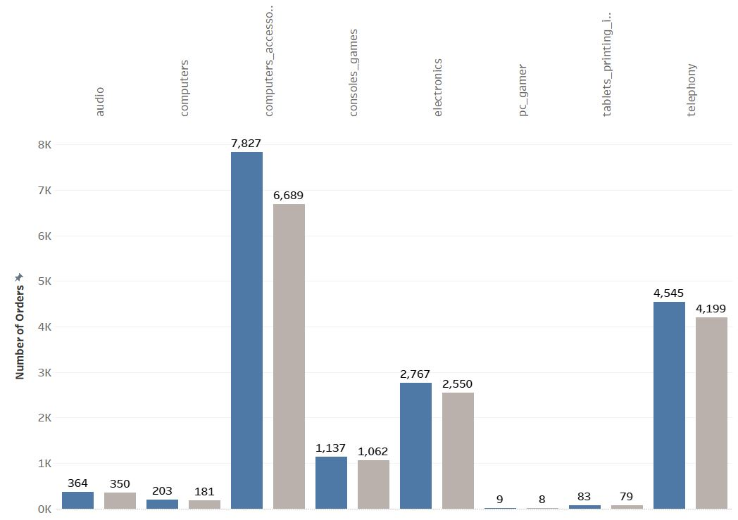
Delivery Performance on Tech Products
With over 90% of tech products delivered on time. Magist demonstrates their ability to manage high volumes as well as maintaining delivery performance.
*Return data is not available in dataset.
Number of Orders
Number of Delivered On Time

Slide 6
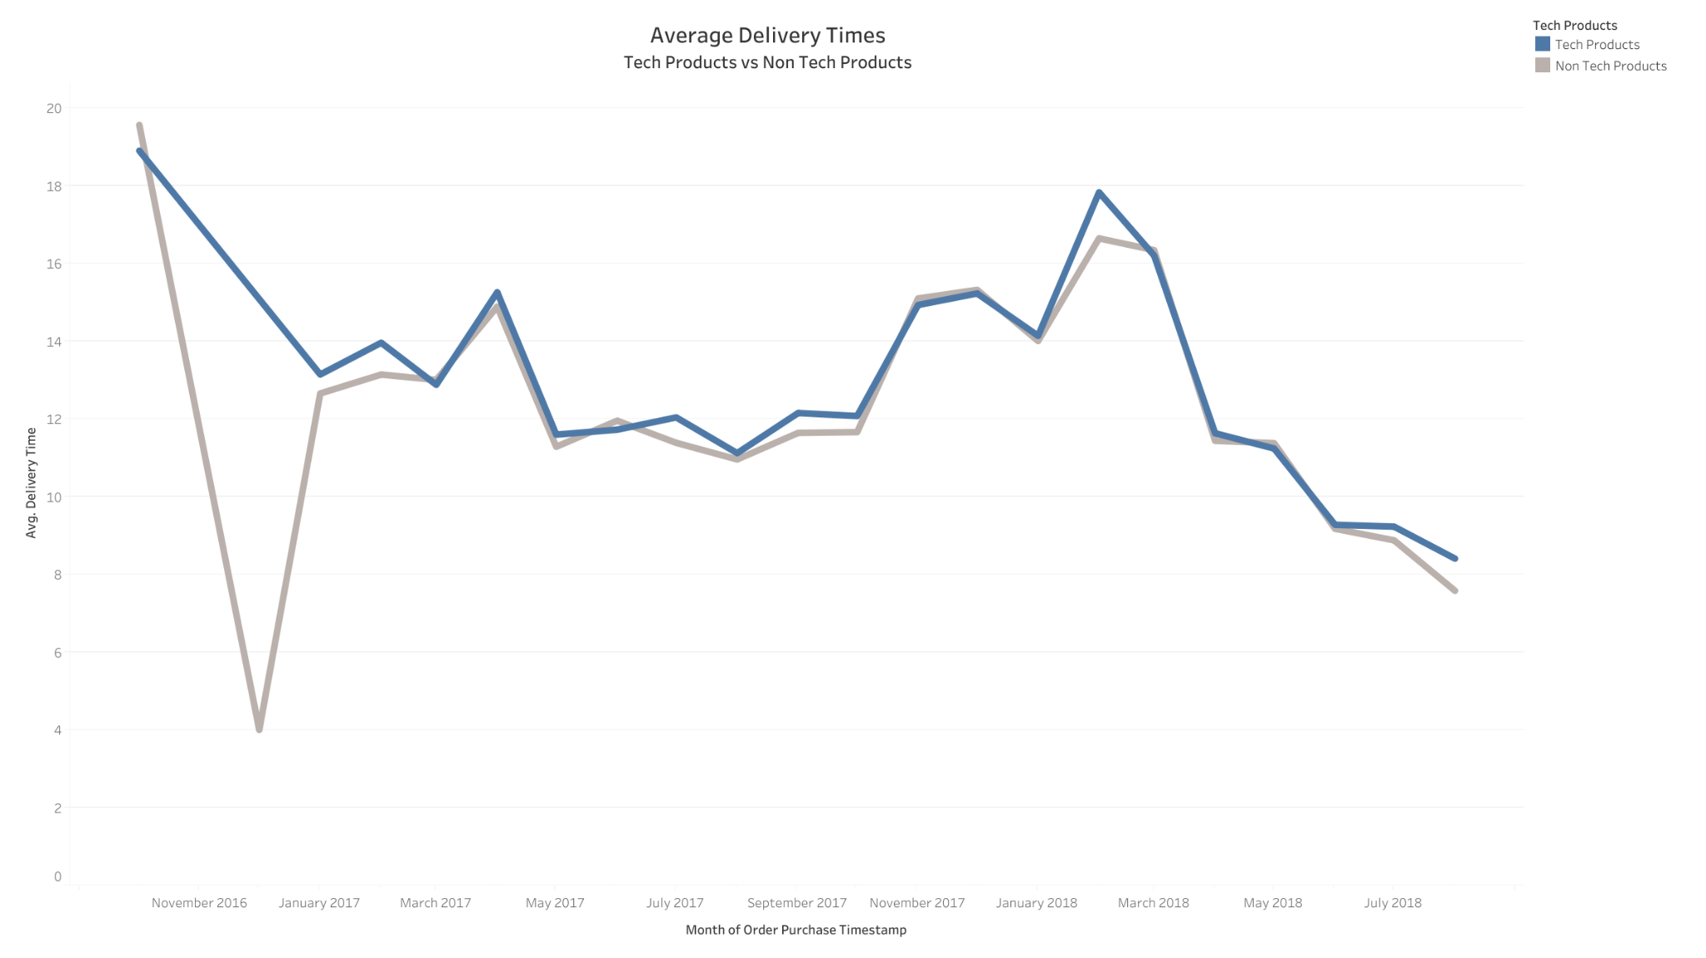
Average Delivery Time
Both tech and non-tech products have seen a consistent decrease in average delivery time since 2017.
Magist stands out from the crowd with an average delivery duration of 12 days, compared to the national average of 21 days for other online companies in Brazil¹

Slide 7
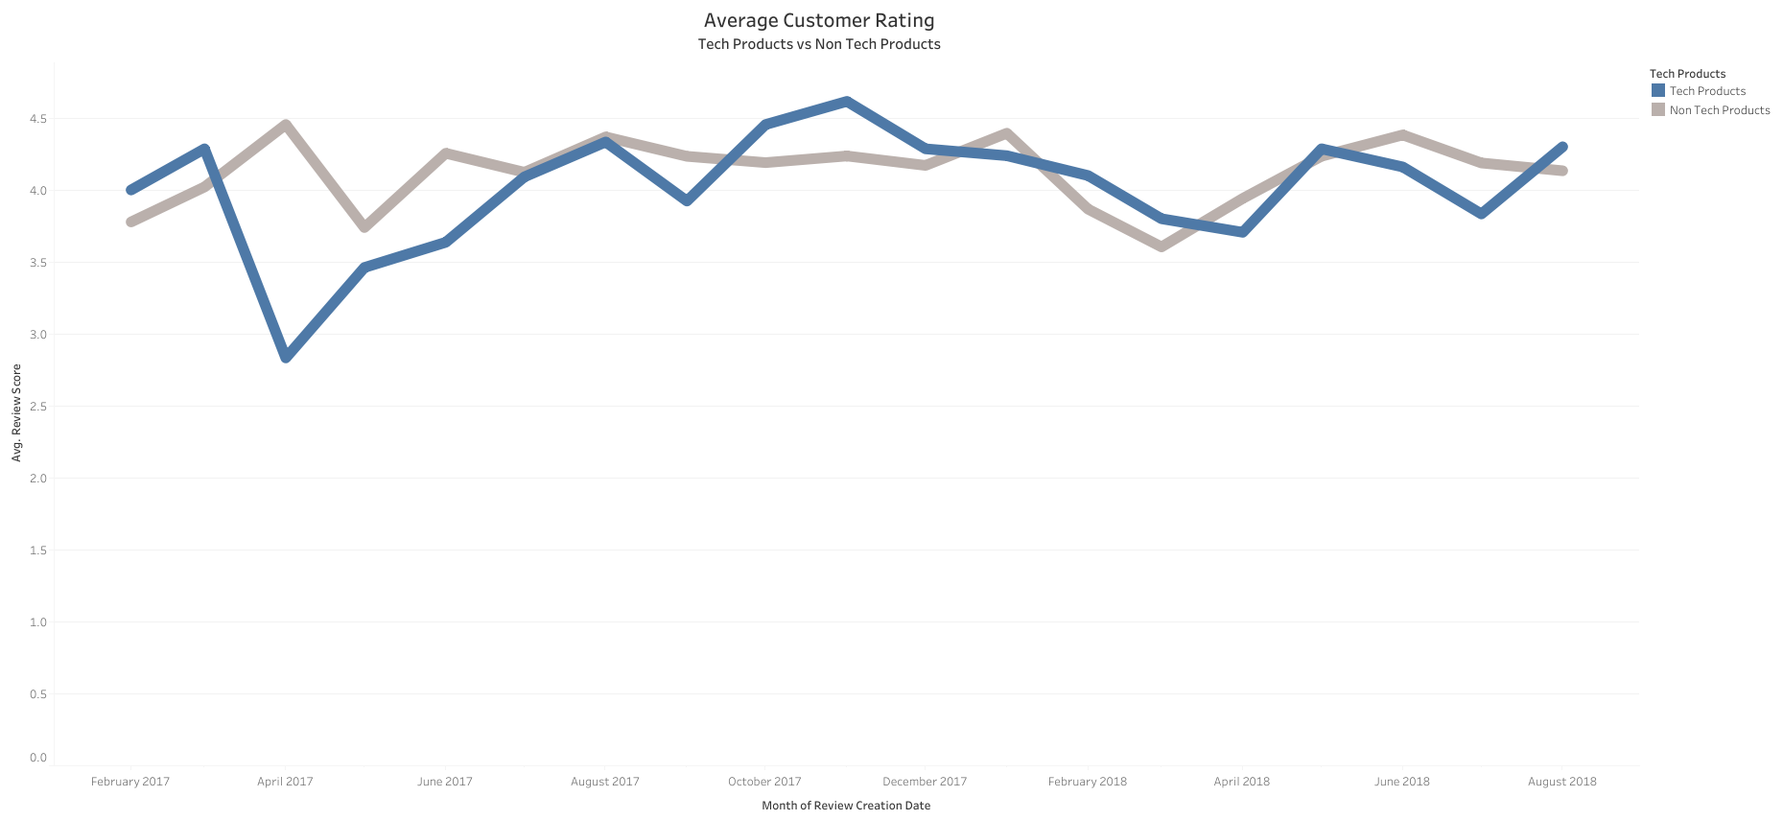
Average Customer Rating
The average customer ratings for both tech and non-tech products are almost same level i.e. approx. 4.3 which shows the consistency of customer satisfaction.

Slide 8
Outside Magist Market Analysis
Brazilian consumers like purchasing electronics online, as the report reveals ‘consumer electronics’ to be the ‘most bought’ online product in 2017.
The brazilian market consider to be the 5th largest smartphone market with estimated 23.9 million units expected to be sold.
52% of the buyers prefers to buys products only from local ecommerce websites, and that shows a great potentials to join the brazil market and sell our products from our local platform inside brazil.

Slide 9
Conclusion
Given the available data, Magist appears to be an efficient partner for entering the Brazilian eCommerce market. However, before making a final decision. We would recommend further investigation into high-end tech products performance and acquire more data on return products.

Slide 10
Sources
¹Summary of Brazil Ecommerce Report 2018
²Statista
³Apple faces competitive hurdle in Brazil market (phys.org)

